Slide 1
Inscribing a Parabola Inside a Rectangle

Slide 2

Question
75
Inscribe a
parabola in the
given Rectangle
100

Slide 3
Solution
75
V
100

Slide 4
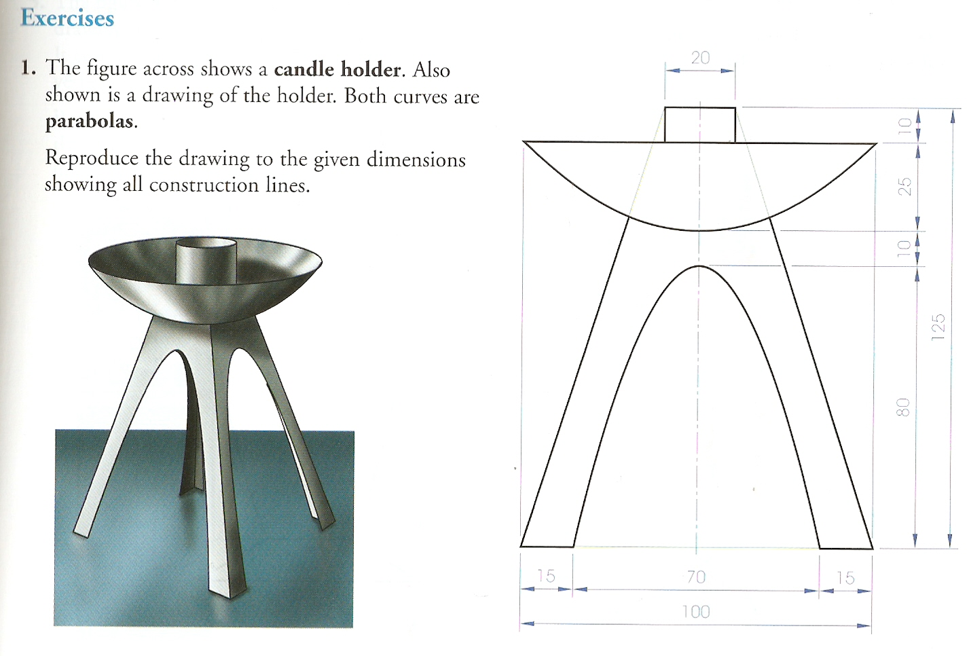
Page 165 Exercise 1

Slide 5
Solution

